Slide 1
Introduction to xsl
Week 6

Slide 2
Introduction
(XML) was designed to make information sharing and data interpretation easier.
Basic rules of XML,
Explains its syntax,
Covers more advanced topics such as styling your XML with CSS and manipulating XML content using XPath and XSLT.

Slide 3

What is the basic difference between XSL and XSLT
XSL is a language for expressing stylesheets. It consists of three parts:
* XSL Transformations (XSLT): a language for transforming XML documents
* The XML Path Language (XPath): an expression language used by XSLT to access or refer to parts of an XML document.
* An XML vocabulary for specifying formatting semantics (XSL Formatting Objects)
Informally, abbreviation "XSL" often refers to XSLT only, since the latter is in wider use. Also informally �XSLT� often refers to both �XSLT itself� and �XPath�, since most of XSLT document use XPath expressions.

Slide 4

Simple XSL(T) elements
This is how you define an XSL Stylesheet.
The template tag contains either a match attribute, which is an xpath expression which determines how the template is matched to the content in the source XML data, or it has a name attribute.

Slide 5

Value of tag.
This also uses an xpath expression, and this is used to select data in the source document.

Slide 6
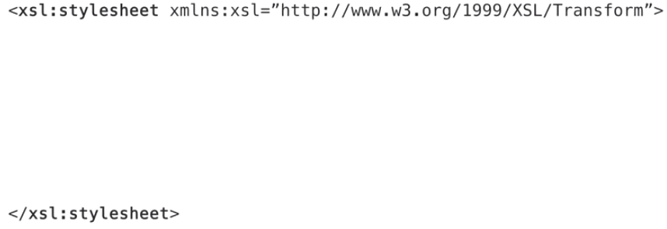
To define a Stylesheet I will use XSL Stylesheet tag

Slide 7
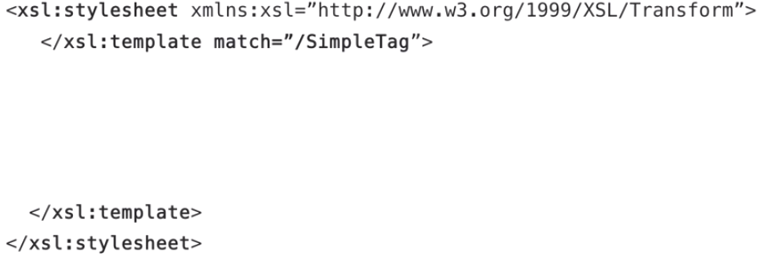
Then I define a template

Slide 8
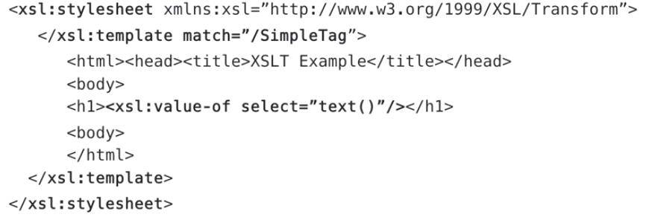
What we need next is our head tags and a body

Slide 9
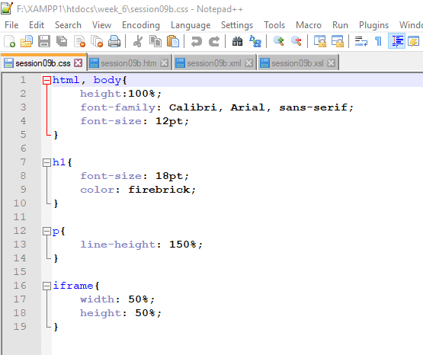
Simple XSLT

Slide 10
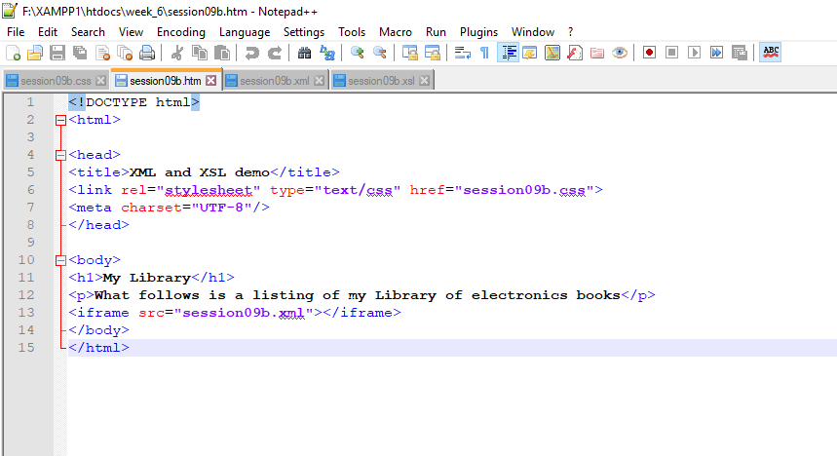

Slide 11
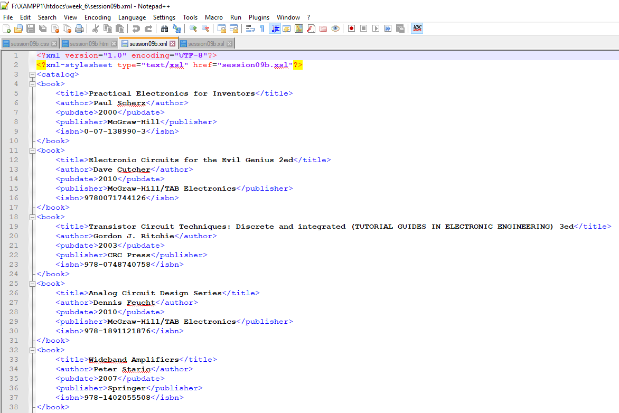

Slide 12
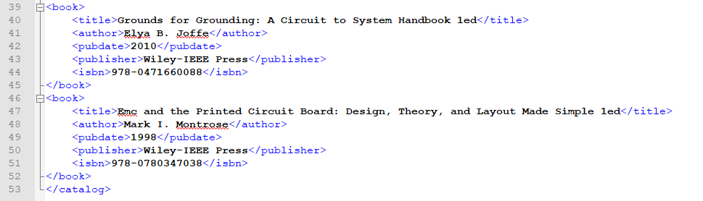

Slide 13
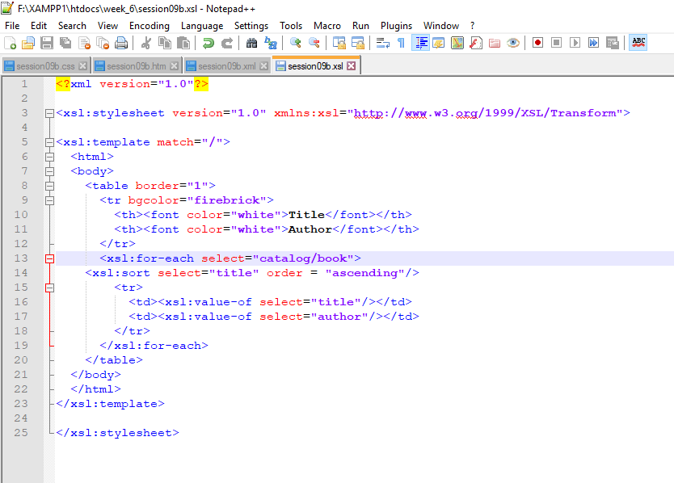

Slide 14
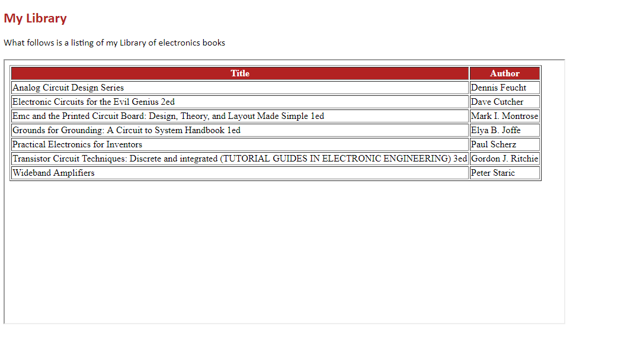
Result

